Slide 1
Financial Aid Avenue Workshop Tutorial

Slide 2
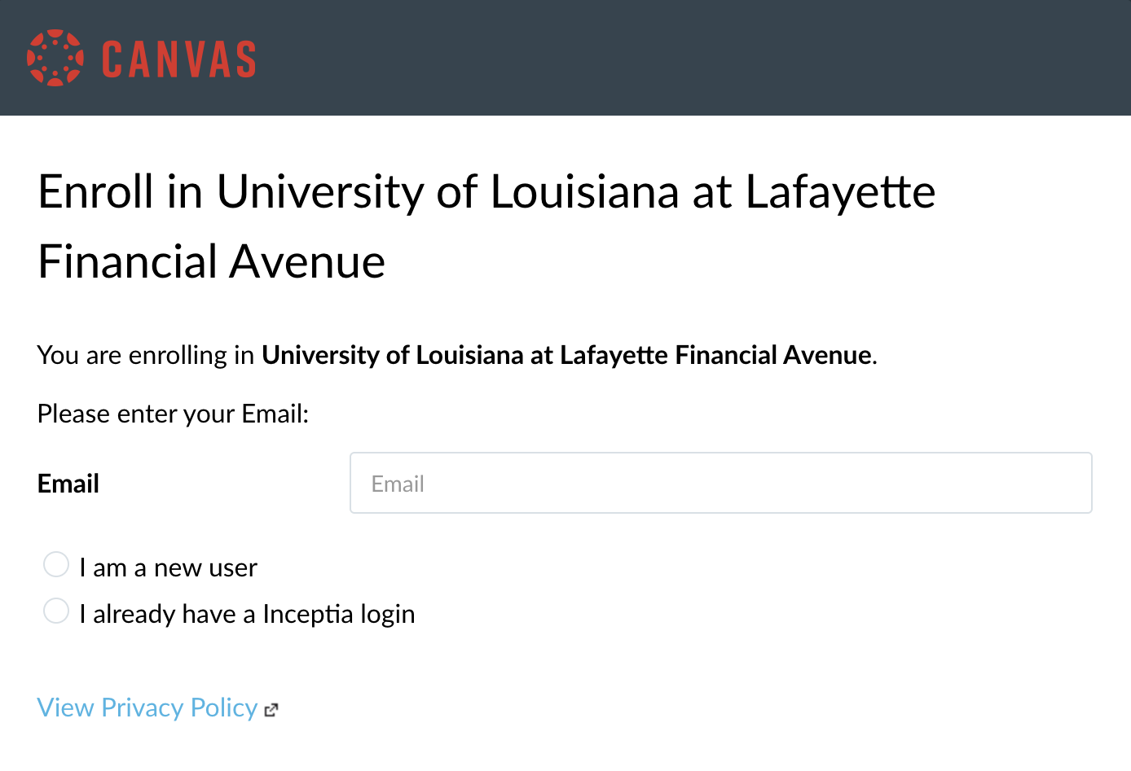
Step One: Click on the link provided on the website, to begin the workshops.

Slide 3
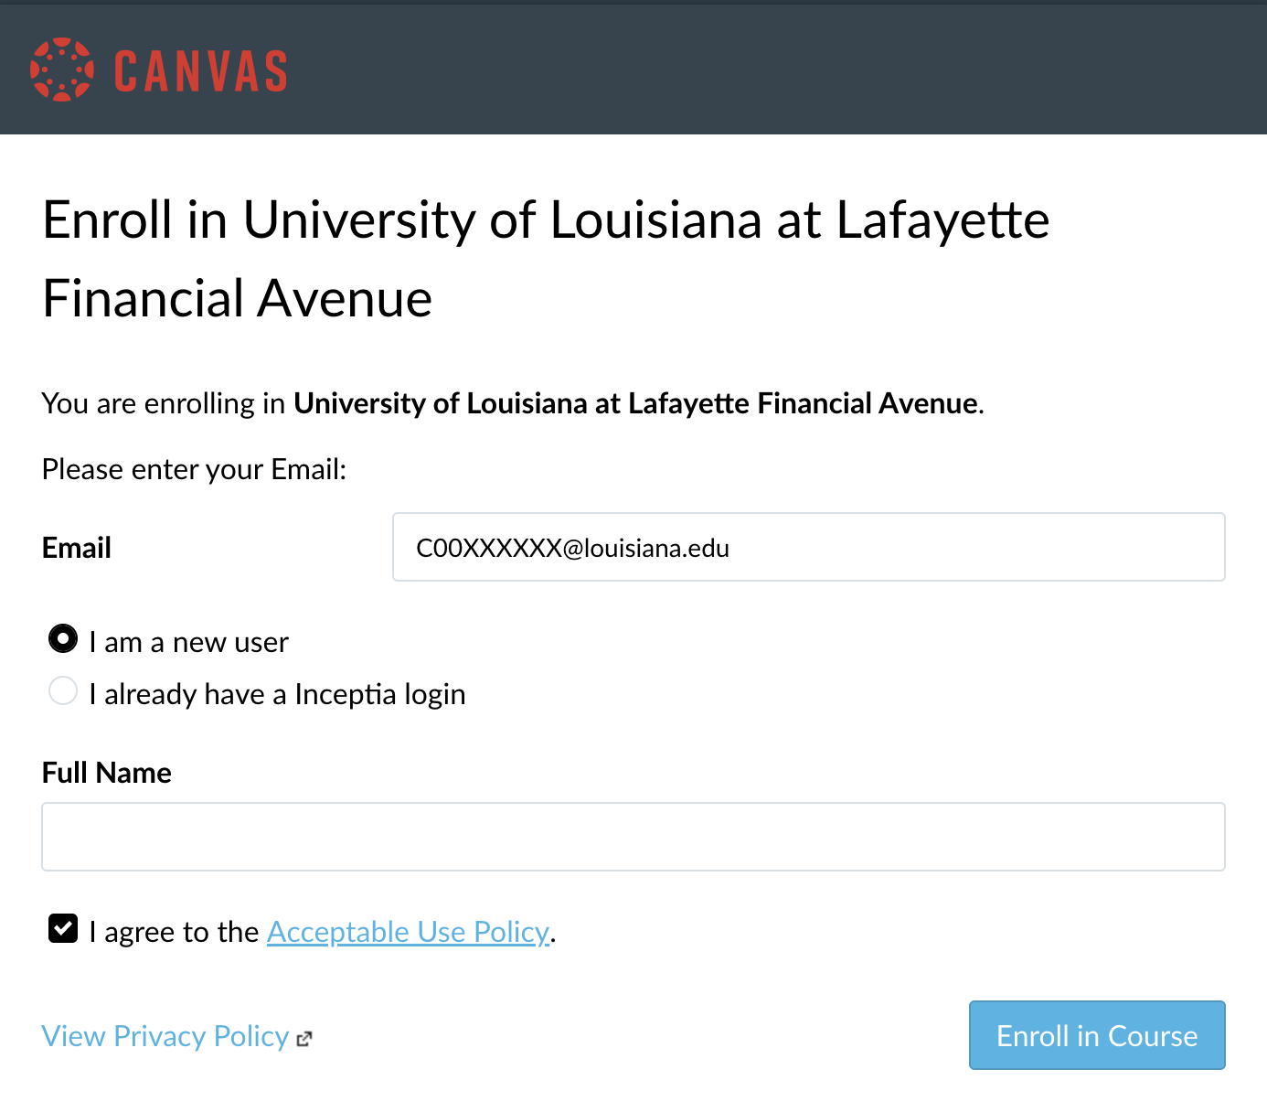
Step Two: Fill out the form with your School Email and Full Name.

Slide 4
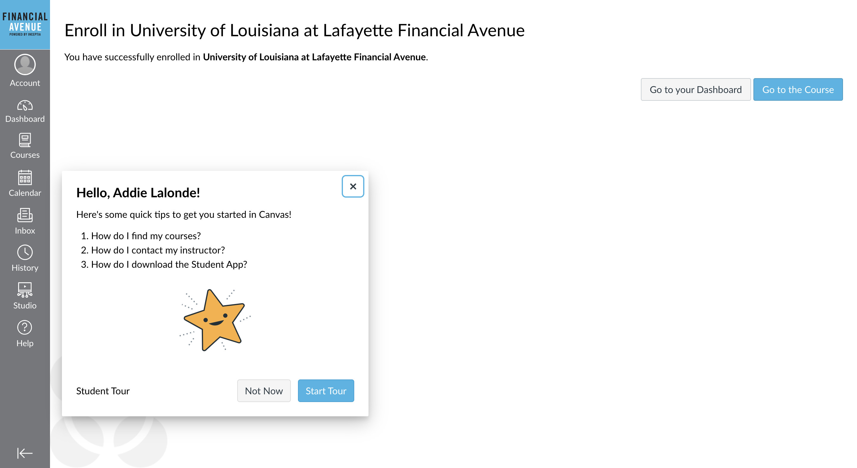
After filling out the form with your information, you will see the welcome screen.

Slide 5
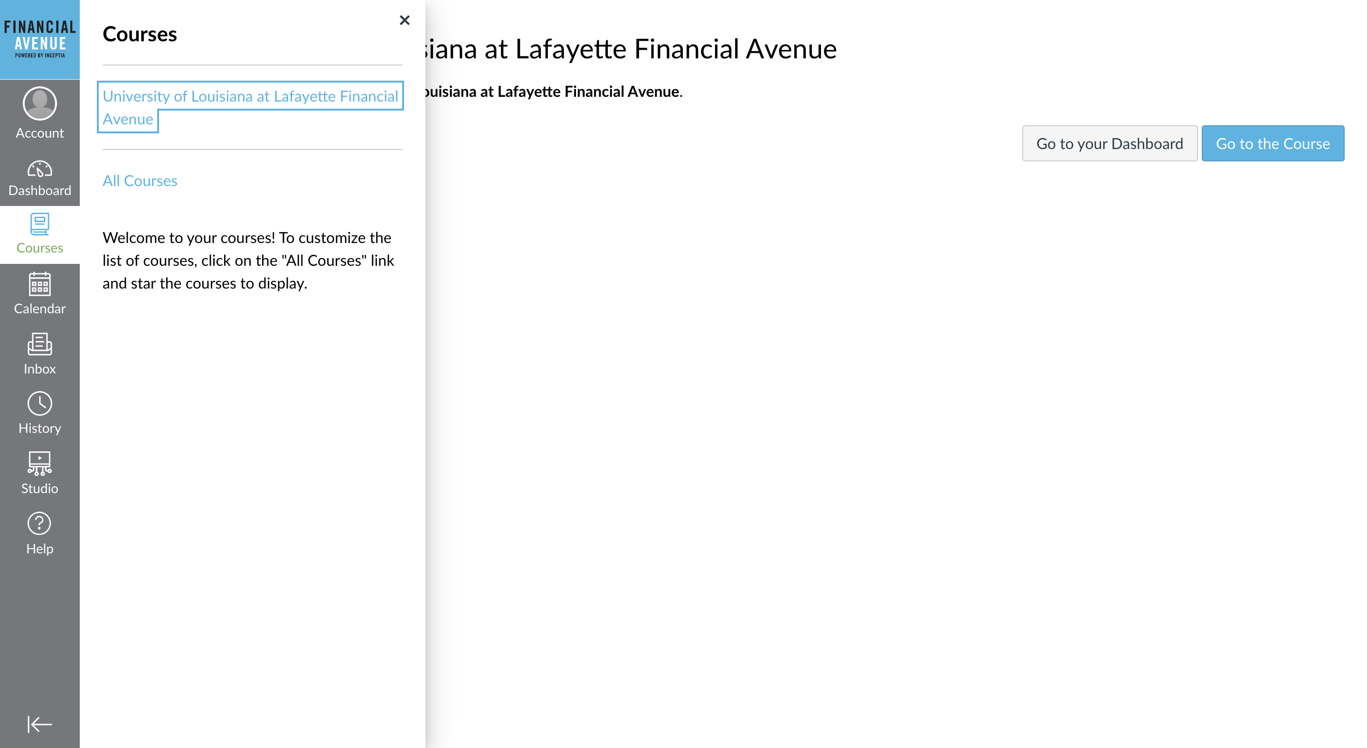
Step Three: Click on “Courses” and Select “University of Louisiana at Lafayette Financial Avenue.”

Slide 6
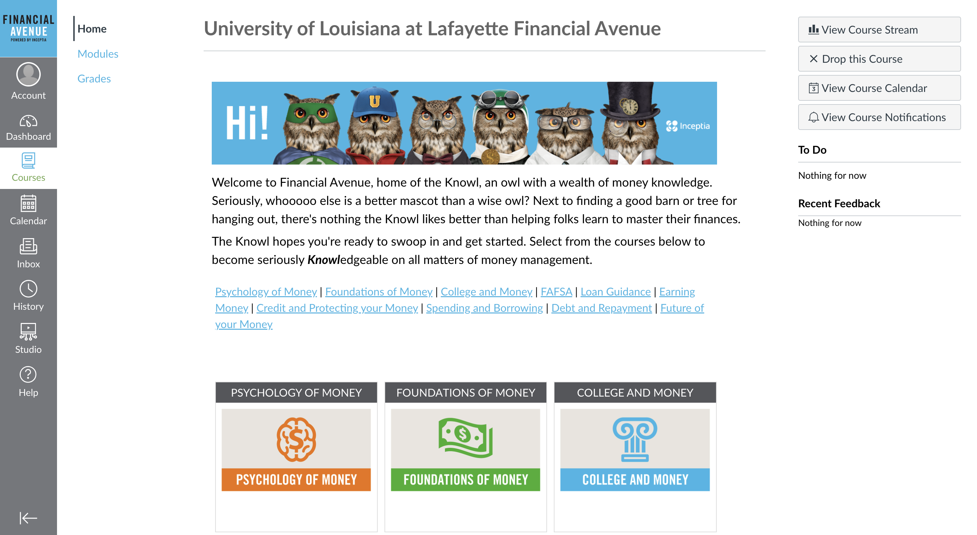
Step Four: Select the Financial Aid Avenue Workshop that you will be taking.

Slide 7
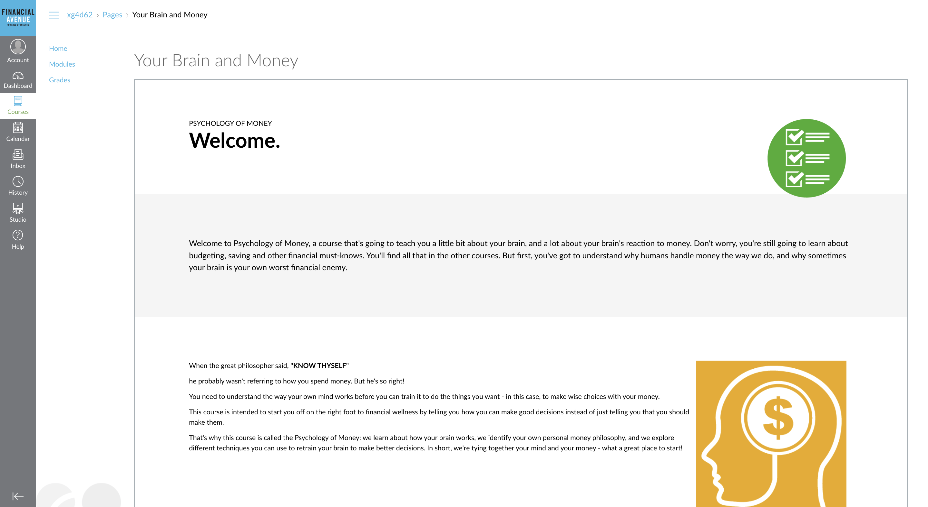
Step Five: Complete the entire Financial Aid Workshop.

Slide 8
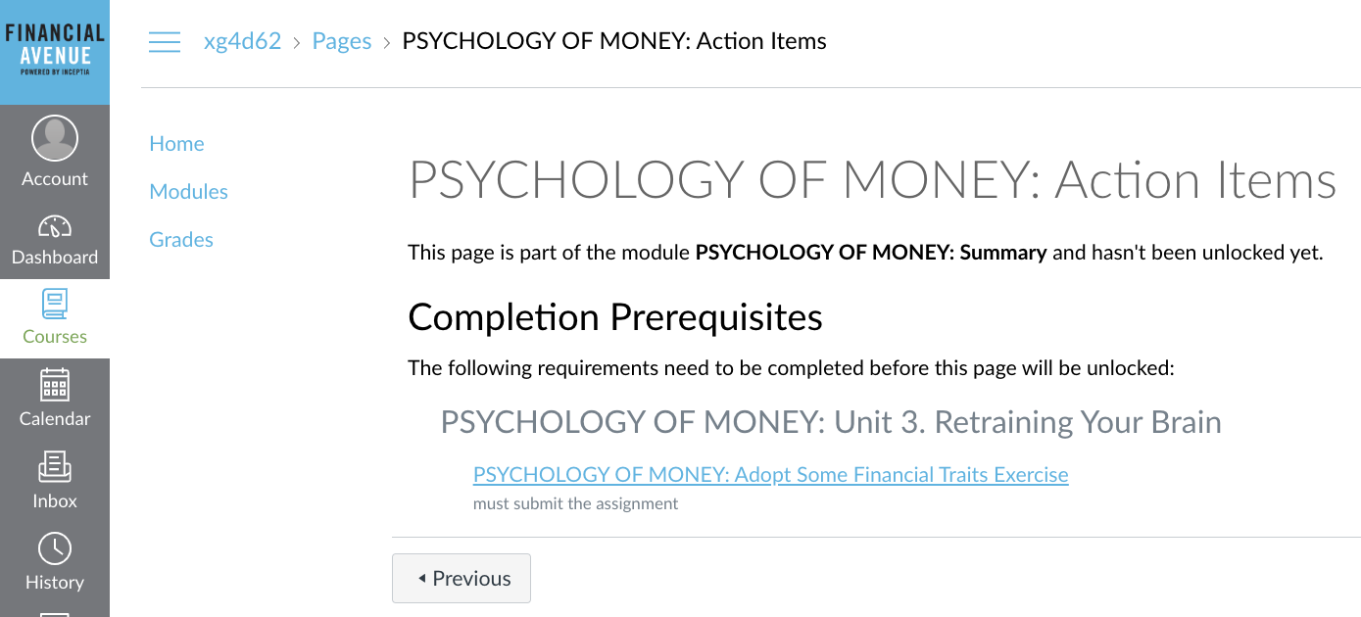
If there is anything in the workshop that was not submitted or completed, you will not be allowed to complete the workshop.

Slide 9
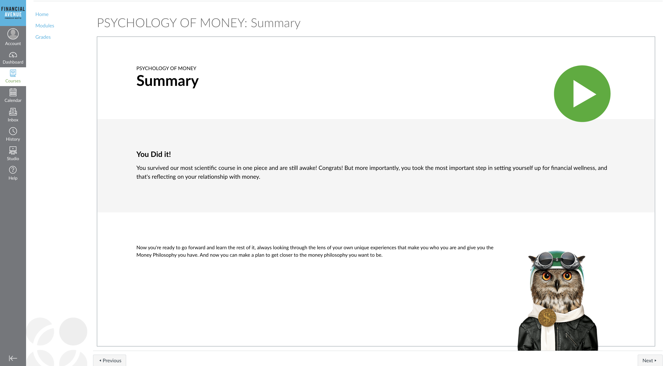
Step Six: Once you have completed the Financial Aid Avenue Workshop, your screen will look like this.

Slide 10
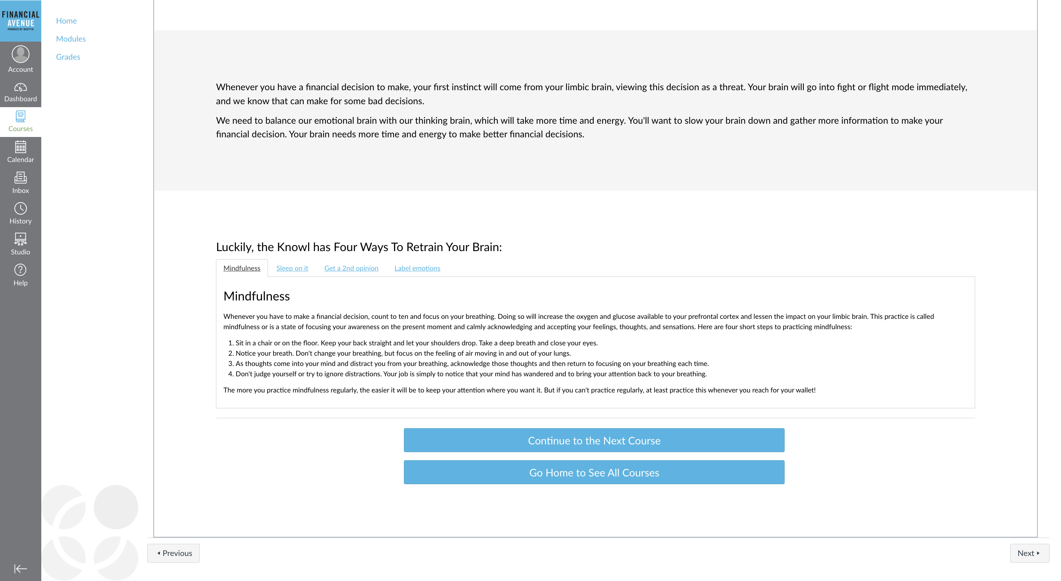
Step Seven: Make sure to read the tips and tricks at the end of the workshop! These are very helpful in becoming responsible with spending money.

